Slide 1

How to build Syntax Checker Extension for VS Code

Slide 2
Task decomposition
Check syntax
Create extension
Provide text to syntax checker and show the results

Slide 3
Check syntax
Context-free grammars
Lexers and parsers
ANTLR4
https://www.antlr.org/
http://lab.antlr.org/
https://www.antlr.org/api/maven-plugin/latest/examples/simple.html

Slide 4

Fun grammar
Thoughts about the programming language with embedded SQL
fun getUserName(id) {
from users {
select name, surname
where user_id = id
}
}
https://github.com/antlr/grammars-v4

Slide 5
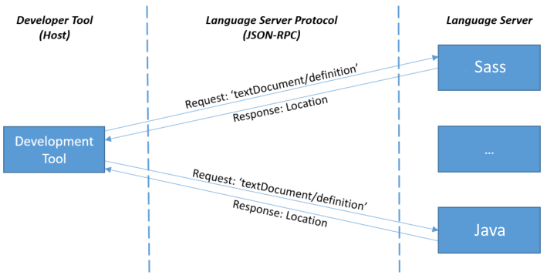
Language Server Protocol
Reuse language features in different developer tools
https://microsoft.github.io/language-server-protocol/

Slide 6
VS Code extension
Create an extension
Register the language id and file extension
Connect with language server
https://code.visualstudio.com/api/get-started/your-first-extension

Slide 7


Thank you!
Any questions?

